Slide 1
EMBL - GRENOBLE
ISPyB meeting – ALBA
Raphael Bourgeas
HTXLab
30th of November 2023

Slide 2
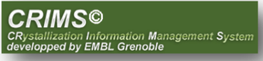



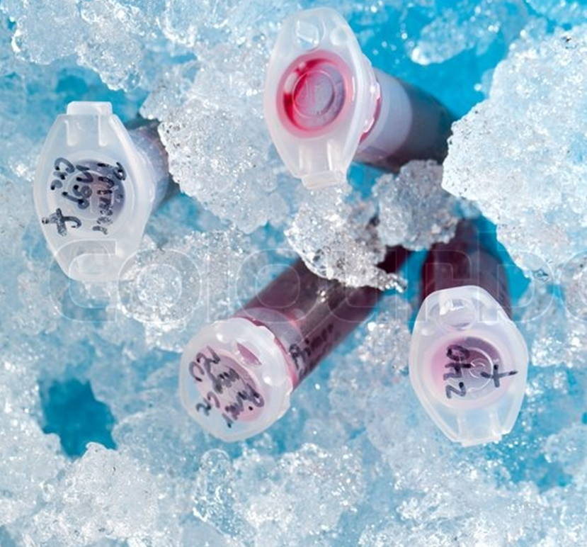
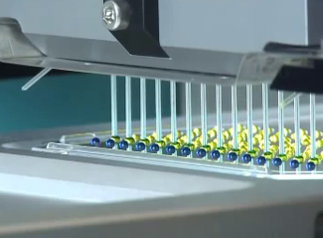
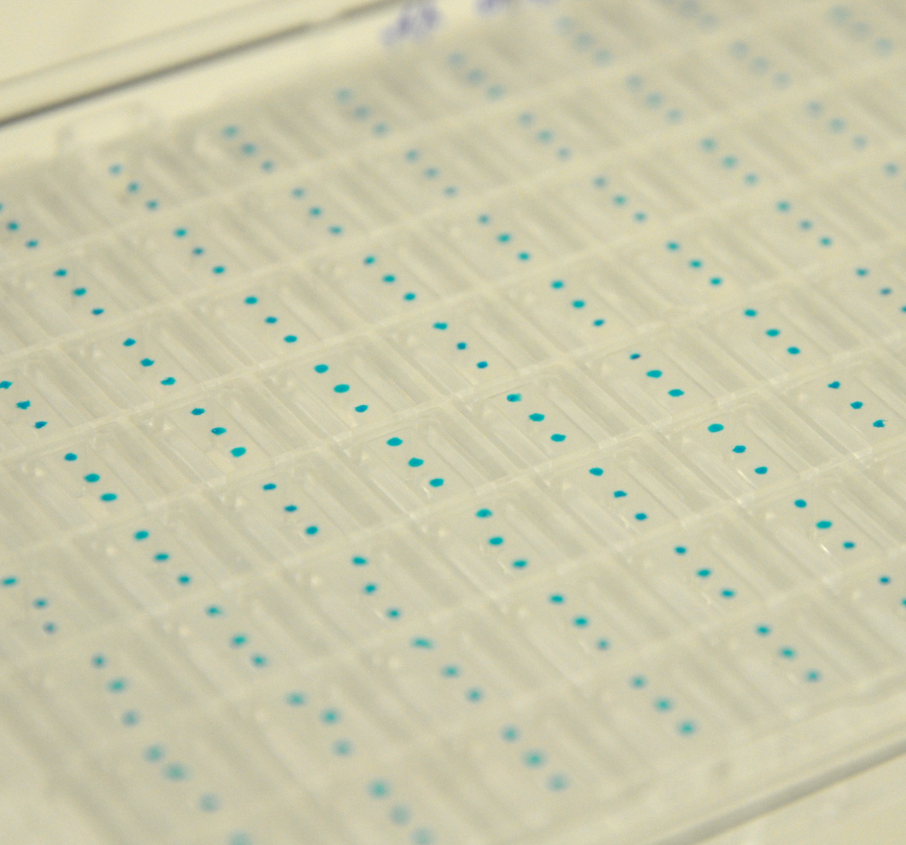
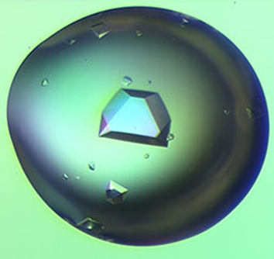
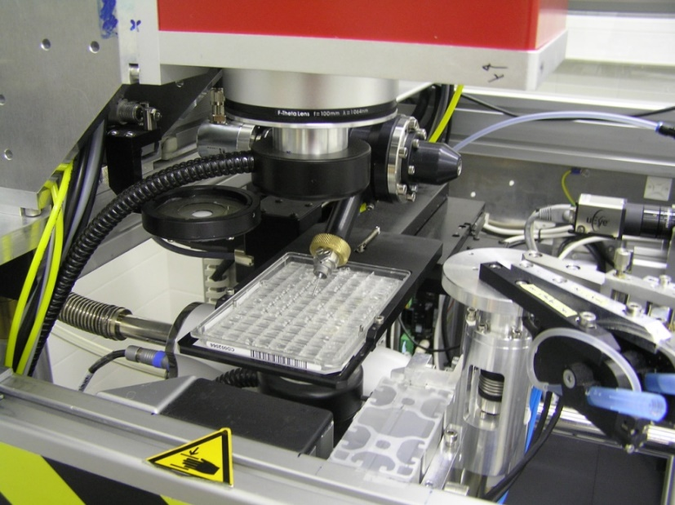
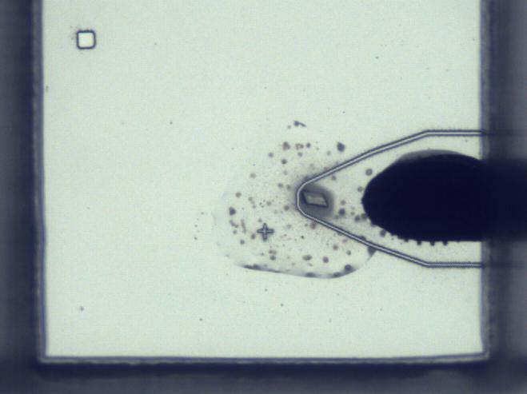
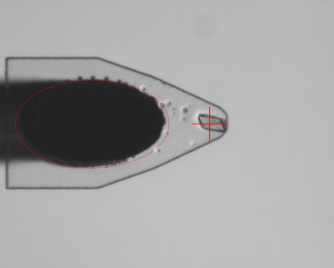
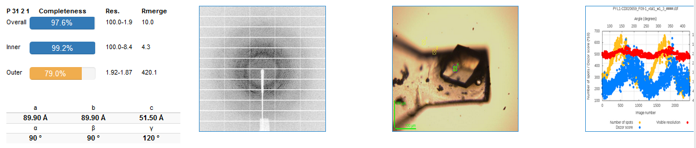

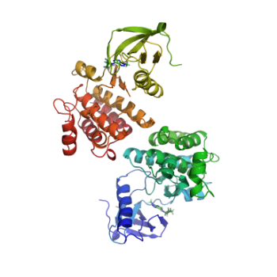
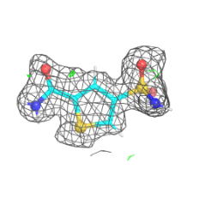
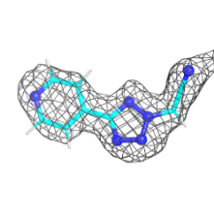
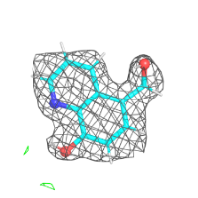
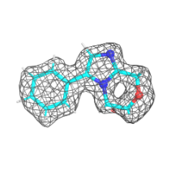
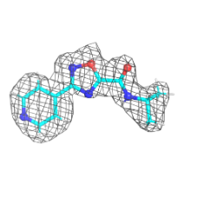
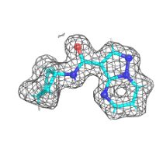
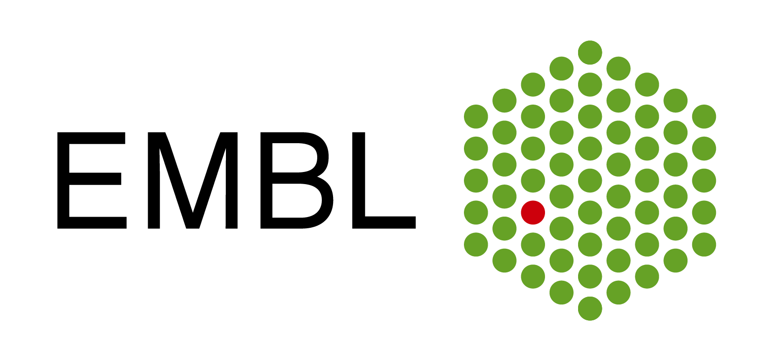




Online Crystallography Pipelines
Fully automated, Protein to structure pipelines operated over internet
High Throughput Crystallization
1300 Scientists supported from 23 Countries
Access to HT crystallization and to synchrotron data collection facilities from your desktop
Removes manual and repetitive operations
Saves time - you can focus on data analysis
Very rapid and high throughput
Easier access for non expert users
Automated Protein-to-structure pipeline
Fully automated, Protein to structure
Fragment Library Screening pipeline
Fully automated fragment screening (1000+ fragments)
CrystalDirect™ Technology
Synchrotron beamlines
Automated data processing
Pipedream
Notes:
CRIMS is a fully automated protein to structure pipelines operated over the internet. It gives access to high throughput crystallization and to data collection facilities right from your desktop thanks to our web application. This allows scientists to save a tremendous amount of time, especially by removing manual and repetitive operations. CRIMS users are able to pilot each part of the pipeline directly from their web browser, from crystallization condition to selecting crystals that needs to be fished in pins and pucks and then shipped to a synchrotron for data collection. Even though CRIMS is already very convenient for regular projects, it shows its full potential for fragment screening campaigns, when users can tests more than a thousand fragment on their protein and have all data and metadata automatically tracked and organized for them in CRIMS. Up to date, more than nine hundreds scientists are already supported by CRIMS just with our installation at the HTXlab, and over fifteen hundreds taking into accounts other facilities running their own version of CRIMS.

Slide 3
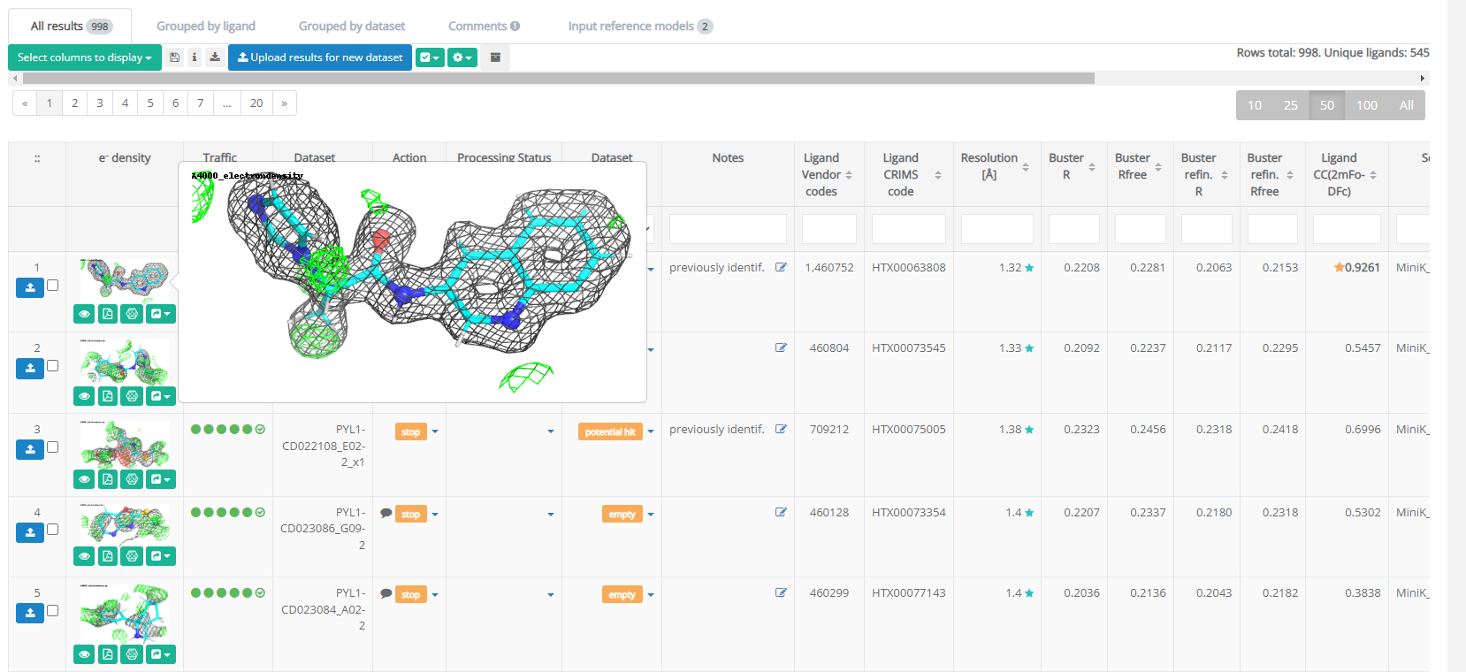
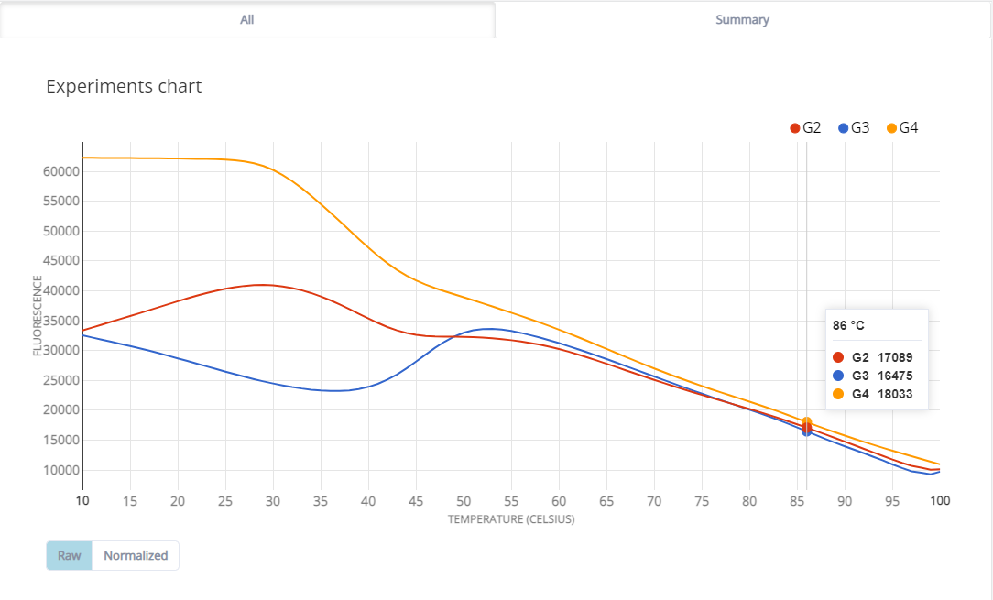
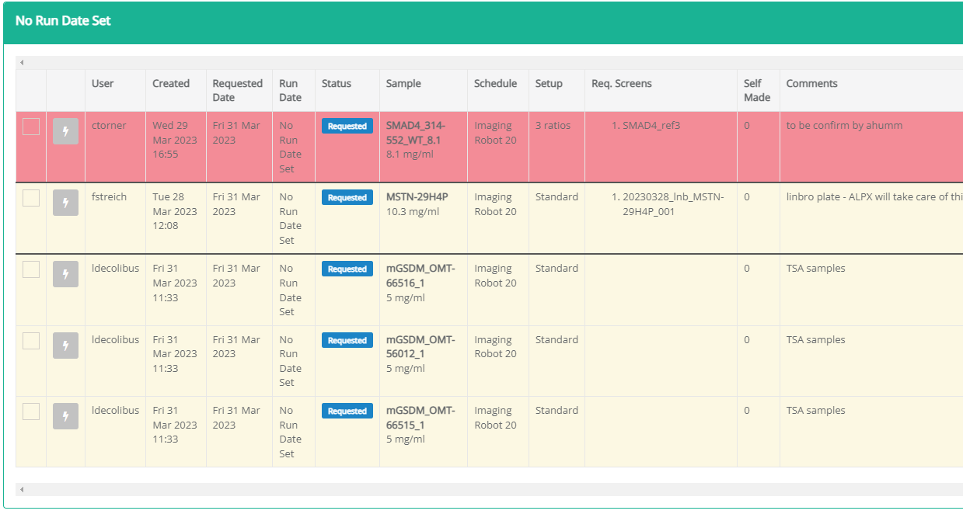
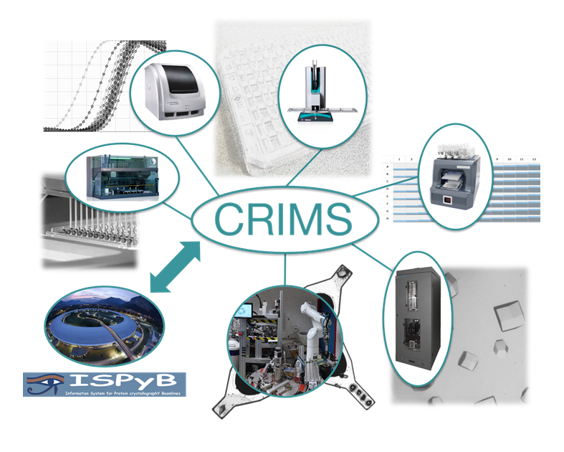
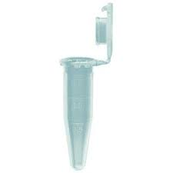

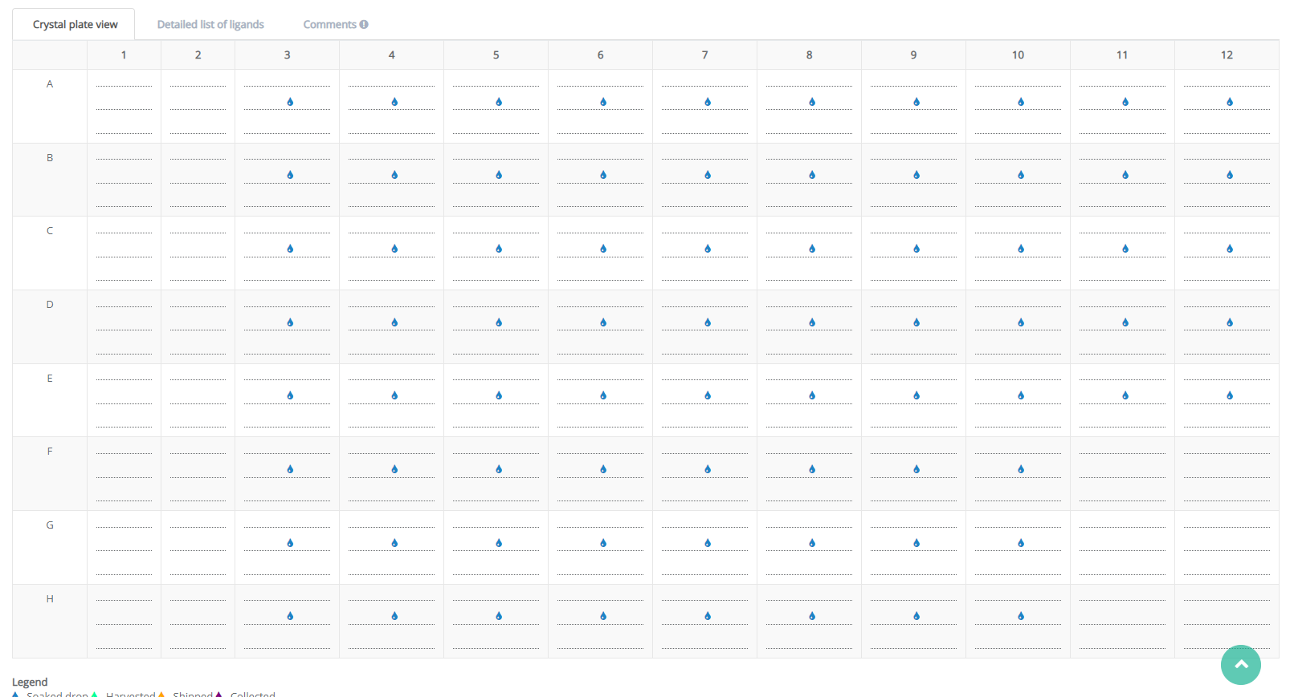
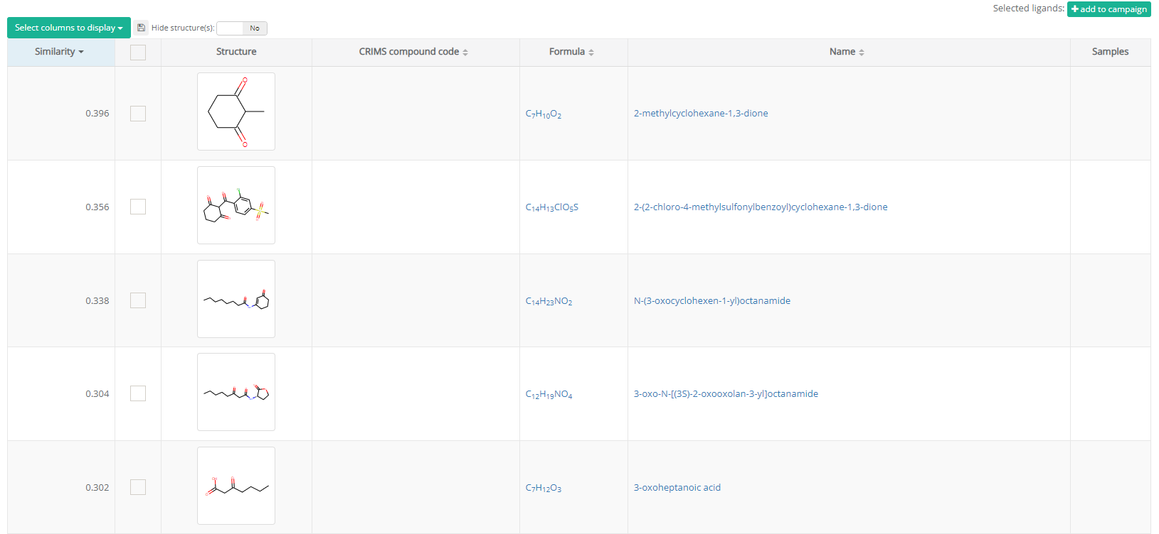
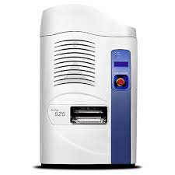
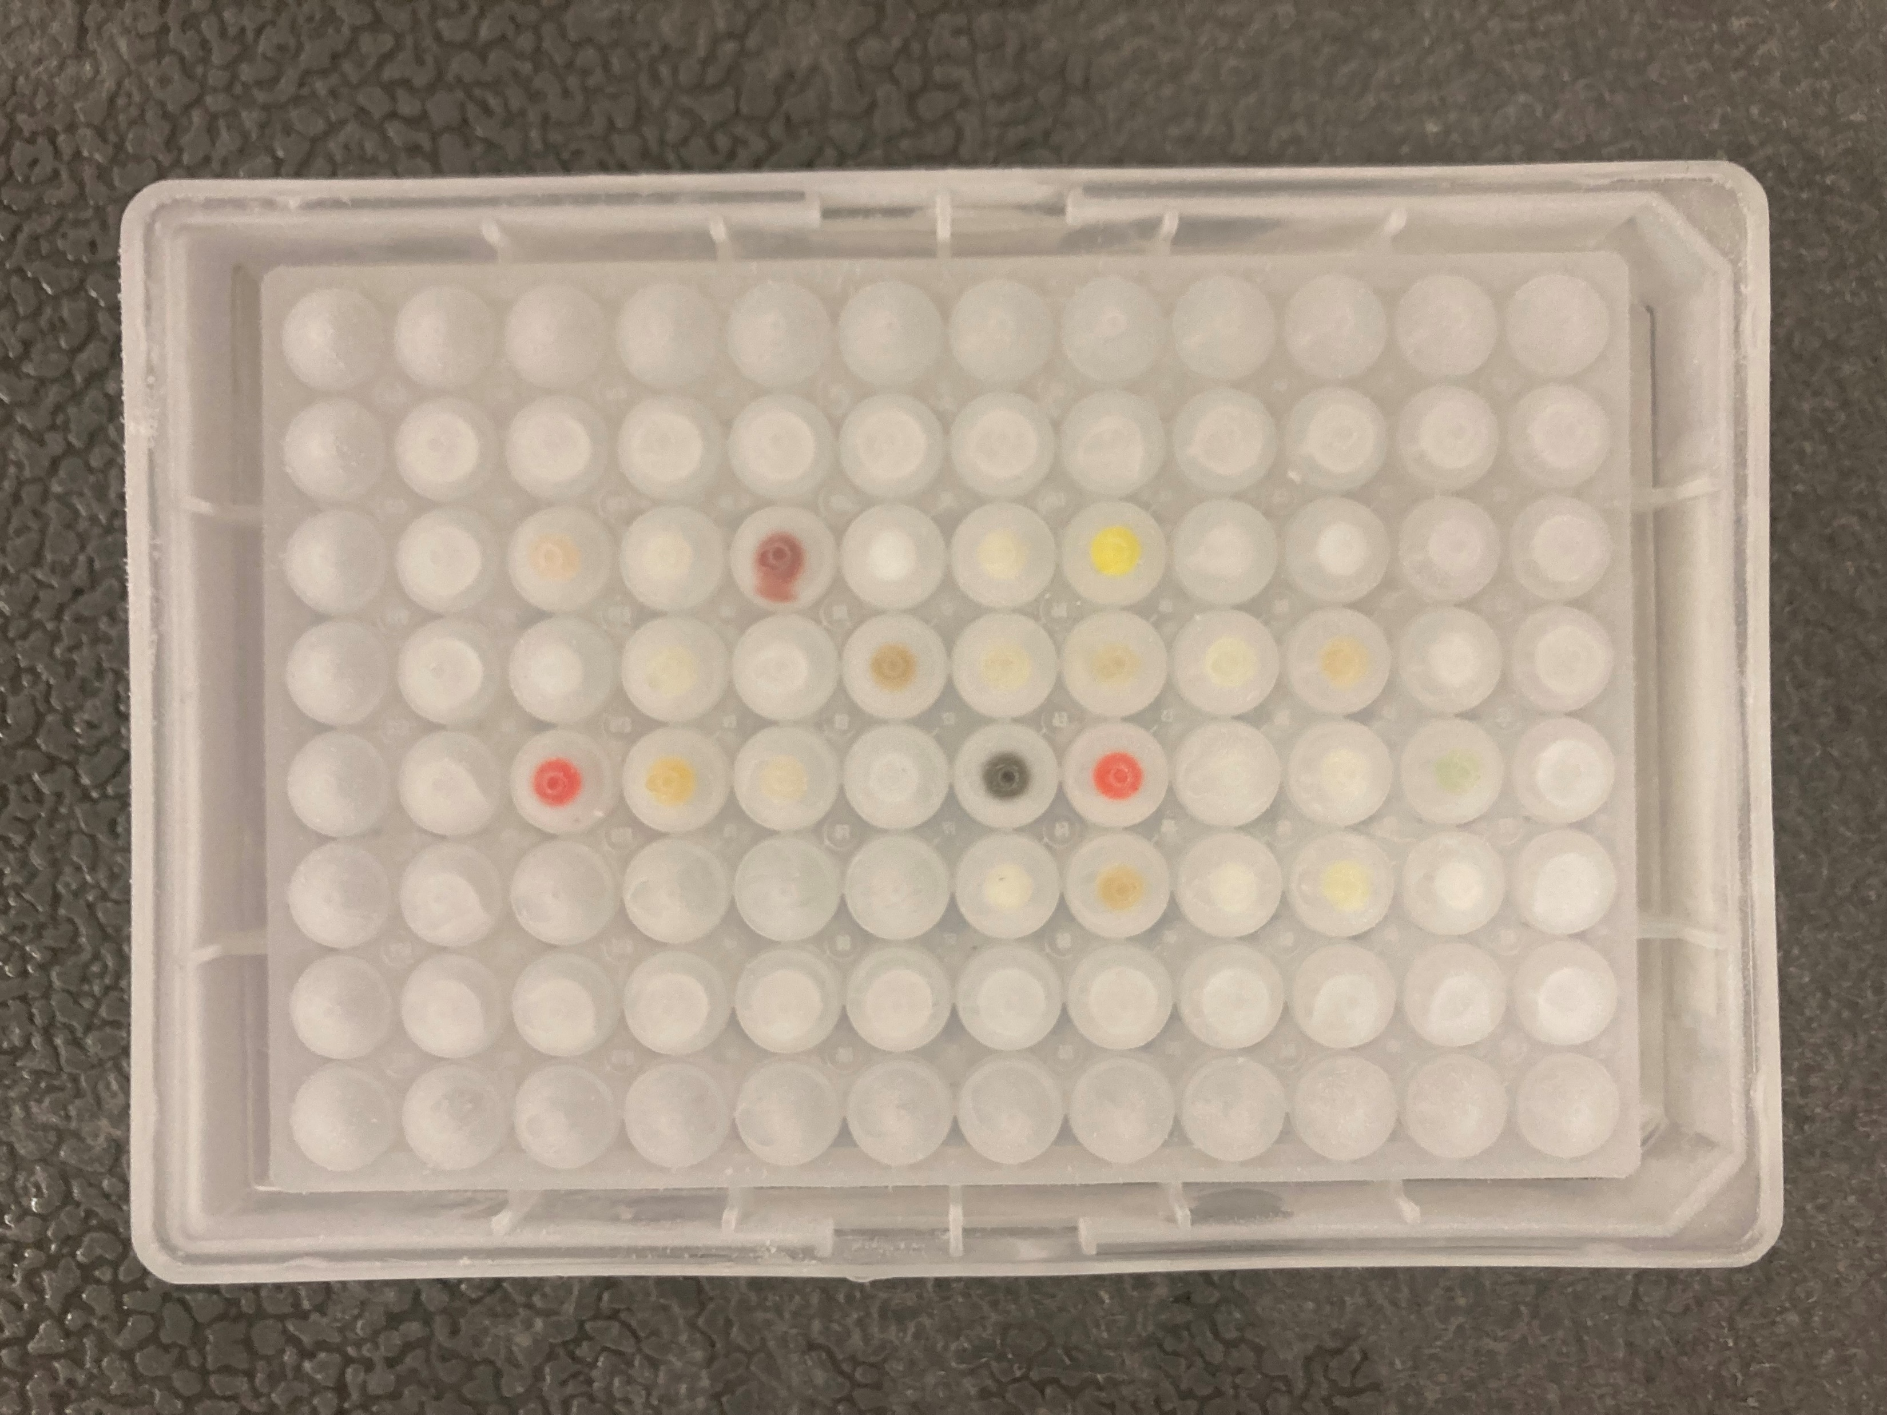
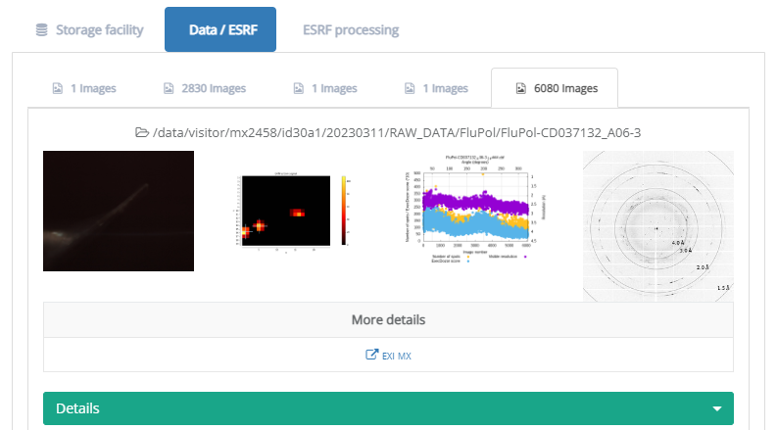
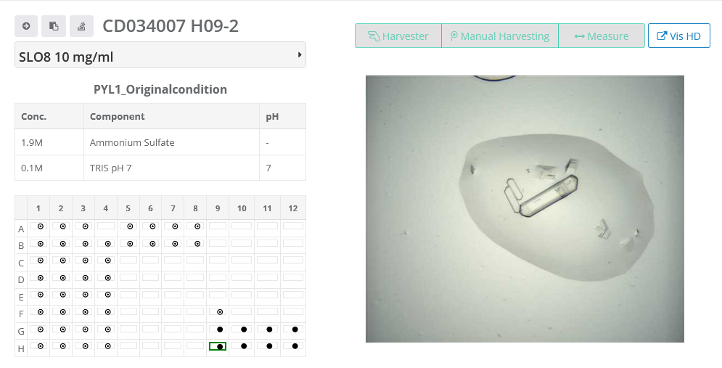
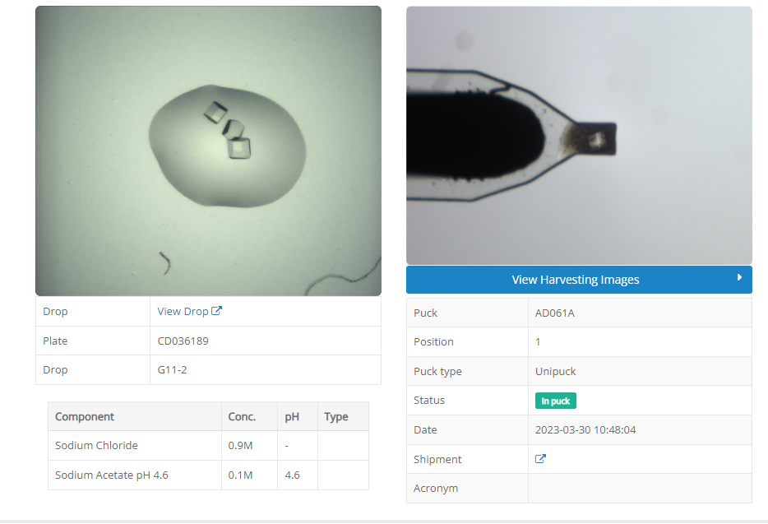
The Crystallography Information Management System (CRIMS)
1300+ Users
28 CRIMS instances
10⁶ Experiments
User

Slide 4
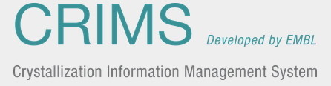


CRIMS - ISPyB Communication: a multiple step process
Authentication
Shipment ID
Data collection group ID
Data collection group results list
Data collection group ID
Token
https://ispyb.esrf.fr/ispyb/ispyb-ws/rest/authenticate?site=ESRF
https://ispyb.esrf.fr/ispyb/ispyb-ws/rest/ TOKEN /proposal/ mxPROPOSAL_ID/mx/datacollection/datacollectiongroupid/ DATACOLLECTION_GROUP_ID /list
https://ispyb.esrf.fr/ispyb/ispyb-ws/rest/ TOKEN/proposal/mxPROPOSAL_ID/mx/sample/shipmentid/SHIPMENT_ID/list
Notes:
Communication between facilities is always more challenging than expected. For example, when retrieving data from ISPyB, an ID is not directly equal to data. Indeed, in order to retrieve information about a data collection, we need to go through a three step process.
First, we need to authenticate, sending to ISPyB a login and password,
and ISPyB sends back a token that will be used for all further steps.
We then send the shipment ID generated by ISPyB when the shipment was created, and stored into our database.
This will allow us to retrieve a list of all the data collections IDs created for said shipment.
Finally, using one of these data collection ID, we can query ISPyb in order to retrieve the raw diffraction images location as well as the meta data associated.

Slide 5
CRIMS - ISPyB Communication: a multiple step process
Current sample tracking.
Matching sample names between CRIMS and list of results in data collection group .
Sample names are meant to be displayed on GUI, not to be used in APIs.
Sample names can be identical between each others.
How to facilitate communication / tracking samples
Having a sample uuid inherited from when shipment / samples were created in ISPyB.
Common feature for communication between LIMS.
Crystal uuid
ExternalRef sample uuid

Slide 6
Triggering rather than requesting.
Triggering rather than requesting
Having a url field at the sample level filled upon shipment creation in ISPyB.
When datacollection / dataprocessing is finished. Call this url, providing:
Url to datacollection results
Temporary token embedded in url
Datacollection results url / ISPyB token
Data collection metadata
Inherited url / CRIMS token

Slide 7
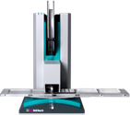
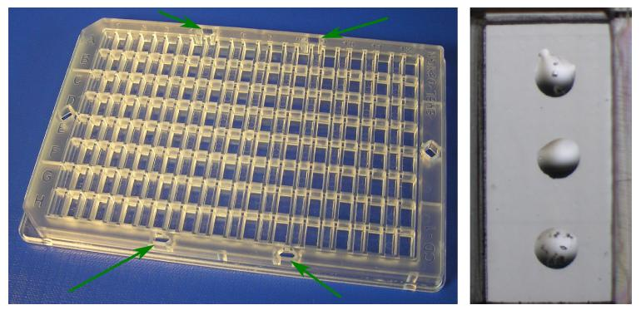
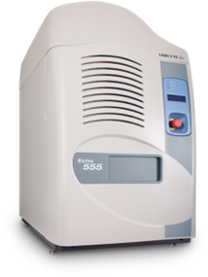
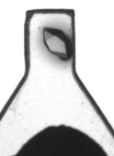
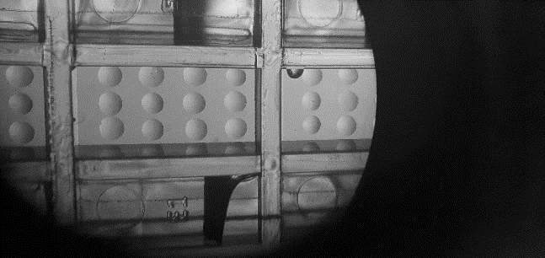
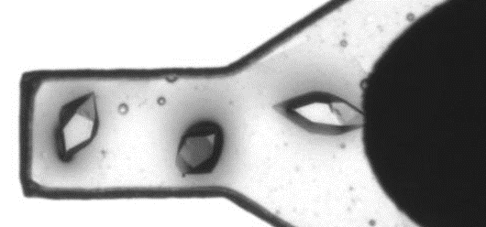
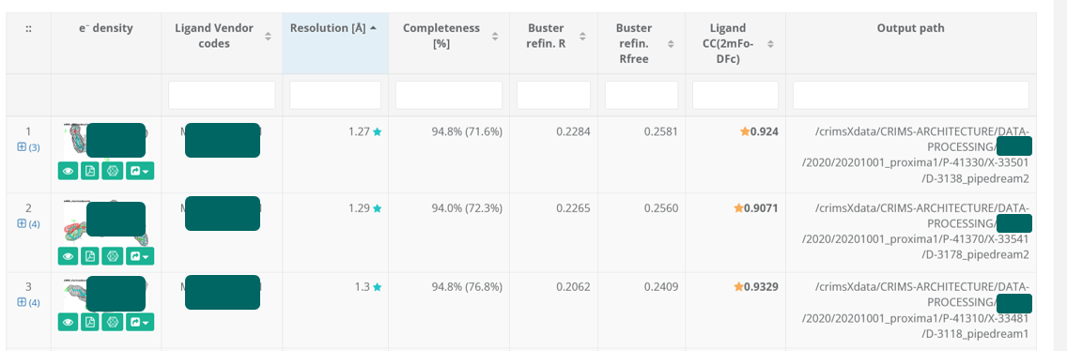
High density X-ray crystallography screening
Current Technology
High Density Technology
Matching done manually
Externally of CRIMS.
Looking at pins images.
Necessity to track crystals on top of pins.
Mosquito
3 drops/well
200 nL
1 ligand / harvesting
Echo acoustic handler
12 drops/well
50 nL
3 ligands / harvesting

Slide 8

Thank you for your attention.

